Slide 1
Speech Emotion Recognition (SER)
By
Pranay manikanta Narava
Prepared for UMBC Data Science Master Degree
Data 606 Capstone project
By
Dr Chaojie (Jay) Wang

Slide 2
Introduction
What is Speech Emotion Recognition (SER)
Significance of SER
Notes:
What is Speech Emotion Recognition?
Speech Emotion Recognition (SER) is an innovative machine learning application to analyze and interpret the emotional state of human being though they speech. By applying artificial intelligence, my aim is to decode the intricate patterns within voice signals, and provide a deeper understanding of the speaker's emotional state.
Significance of SER
our world increasingly dominated by digital communication, understanding emotions in speech is pivotal. From customer service interactions to mental health assessments, the ability to recognize and respond to emotions plays a crucial role in human-machine interactions. This project endeavors to contribute to this field, unlocking new possibilities for emotional intelligence in technology.

Slide 3
Overview
The primary objective of this project is to develop a robust Speech Emotion Recognition (SER) model that can accurately identify and classify the emotions conveyed through a speaker's voice. My aim is to achieve the following key goals:
Accurate Emotion Classification
Cross-domain Applicability
Real-world scenarios & Applications
Notes:
Accurate Emotion Classification: By Implement a machine learning model which is capable of accurately classifying a diverse range of emotions, like happiness, sadness, anger, surprise, and 4 more other type of emotions.
Cross-domain Applicability: Ensuring that the development of this model is applicable across various domains, from customer service interactions to virtual assistants, fostering emotionally intelligent human-machine interactions.
Real-world scenarios & Applications : Emotions are a fundamental aspect of human communication, influencing the way we convey information, build relationships, and make decisions. Incorporating emotion recognition technology into communication systems offers several advantages: such as Customer Service Optimization & Healthcare Applications: In healthcare, emotion recognition can play a vital role in mental health assessments, offering insights into a person's emotional well-being.

Slide 4
Methodology
Dataset Preprocessing
Data Augmentation
Feature Extractions
Model Training & Validation
Load Audio files
Extract labels
Audio Resampling
Resize to Fixed length
Noise
Time shifting
Pitch shifting
Time stretch
STFT
Mel spectrogram
MFCC
CNN model
Dataset
Preprocess
Augmentation
Mel Features
CNN Model
Inference

Slide 5

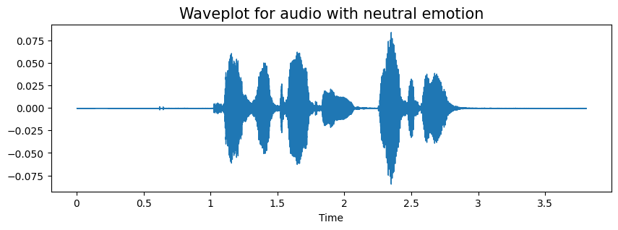
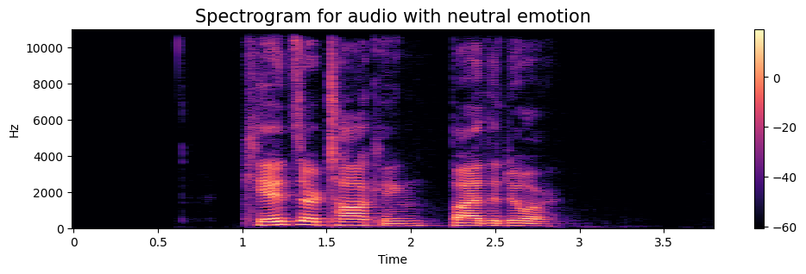
Wave plot and Spectrogram

Slide 6


Architecture
samples
Dataset
Original Audio .wav file
44100Hz
Resampling
22050Hz
Resizing and padding
Augmentation
Mel Spectrogram

Slide 7
CNN - Architecture
Sequential model
Convolutional Layer
Layer 1
Conv1D
LeakyReLU
MaxPooling1D
Dropout
Layer 2
Layer 3
CNN Layers
Layer 4
Flatten Layer
Optimizer = Adam
Learning rate = 0.001
Activation = Relu
Output Activation = Sigmoid
Dense Layer
Output Layer

Slide 8
Results

Slide 9
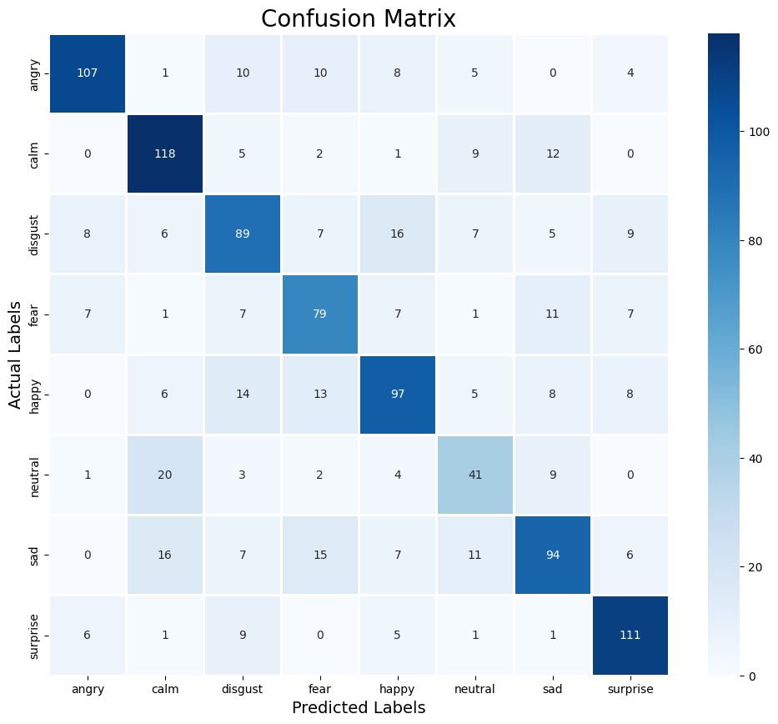
Confusion Matrix

Slide 10
Classification Report
 | Precision | Recall | F1-Score | Support
Angry | 0.83 | 0.74 | 0.78 | 145
Calm | 0.70 | 0.80 | 0.75 | 147
Disqust | 0.62 | 0.61 | 0.61 | 147
Fear | 0.62 | 0.66 | 0.64 | 120
Happy | 0.67 | 0.64 | 0.66 | 151
Neutral | 0.51 | 0.51 | 0.51 | 80
Sad | 0.67 | 0.60 | 0.64 | 156
Surprise | 0.77 | 0.83 | 0.80 | 134
Accuracy |  |  | 0.75 | 1080
Macro Avg | 0.67 | 0.67 | 0.77 | 1080
Weighted Avg | 0.68 | 0.68 | 0.78 | 1080

Slide 11
Conclusion
The model demonstrates effectiveness in speech emotion recognition, with notable improvements in both training and validation metrics. As i move forward, ongoing refinement and exploration of advanced techniques will be crucial for achieving even higher accuracy and ensuring robustness across diverse real-world scenarios.

Slide 12
Thank you
Pranay manikanta Narava
Data 606 Data Capstone project
Campus ID: MT50255

